Slide 1
2019-2020 Predictive Analytics and Modelling of Data – CMSE11428 Group 3
Antonis Photiou, Dimitrios Petkidis, Yury Arutyunov, Vangelis Kappos, Izgi Arda Ozsubasi and Rachad Saab

Slide 2
Introduction
Annual cost of flight delays for the US economy was 31-40 $ billion in 2010.
Different parties are affected (airlines, passengers, etc.).
Aim to assist F9 and MQ airlines by identifying the most notable causes of flight delays and cancellations.
Potential reasons for delays include: weather condition, security issues and maintenance.

Slide 3
Research questions - Delays
Which weather factors are most influential in predicting delays?
Are the studied airlines more affected by weather delays than other airlines?
Does competition affect departure delays?

Slide 4
Research questions - Cancellations
Should the airlines consider changing the time of departure to avoid airport congestion?
How do the various factors affect different types of cancellations?
Which airports and time periods are more affected by weather?

Slide 5
Literature Review
Klein et al. (2010) have used multiple linear regression to predict flight delays
Mann et al. (2017) have used decision tree regression with gradient booster to predict delays
Features previously used to predict delays include: weather, day of the week, carrier type and more.
Rupp and Holmes (2006) have used probit binary regression to predict flight cancellations.
Features previously used to predict cancellations include: level of competitiveness, aircraft age and more.

Slide 6
Metholodgy
Data pre-processing
Predicting departure delay
Predicting flight cancellations

Slide 7

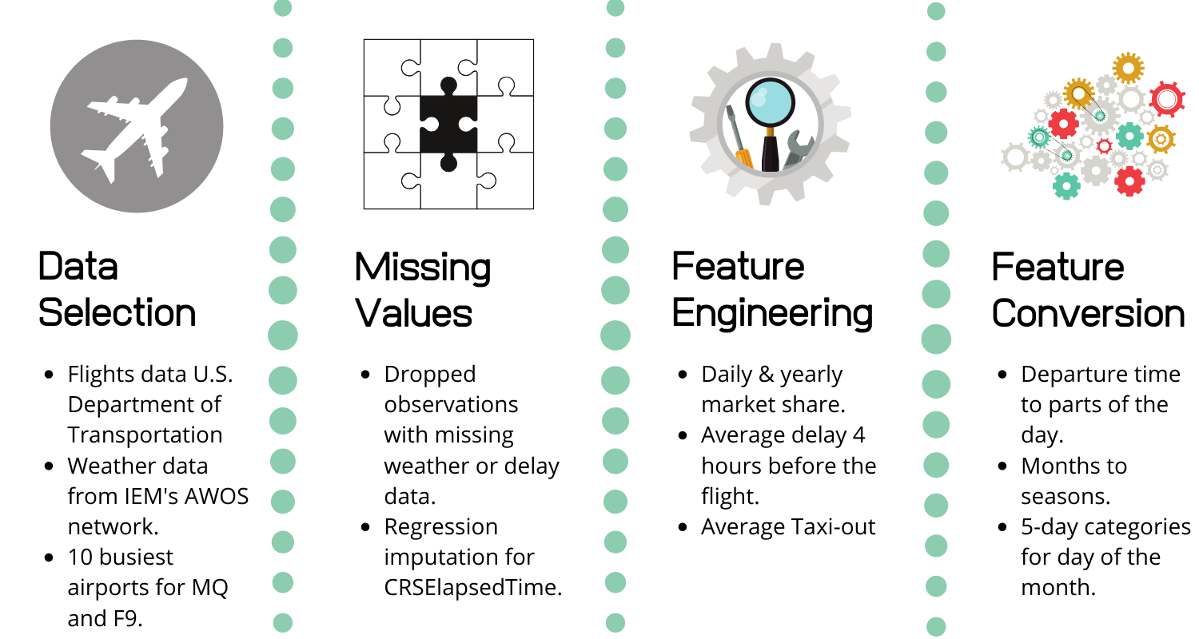
Data Pre-processing

Slide 8
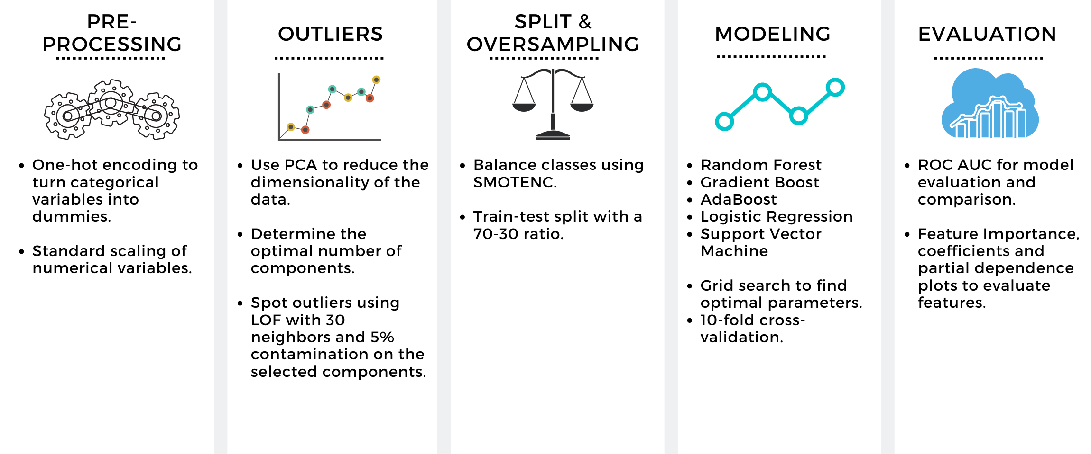
Predicting Flight Cancellations

Slide 9
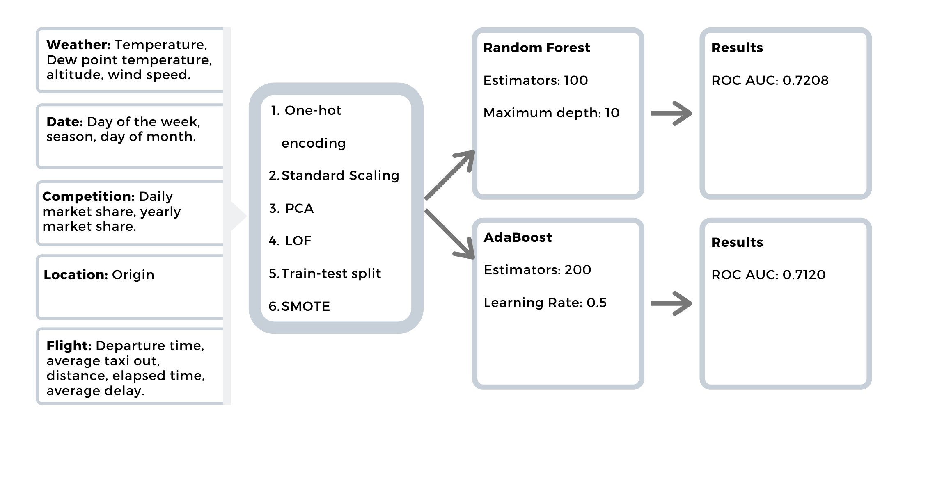
Predicting Flight Cancellations Best Model

Slide 10
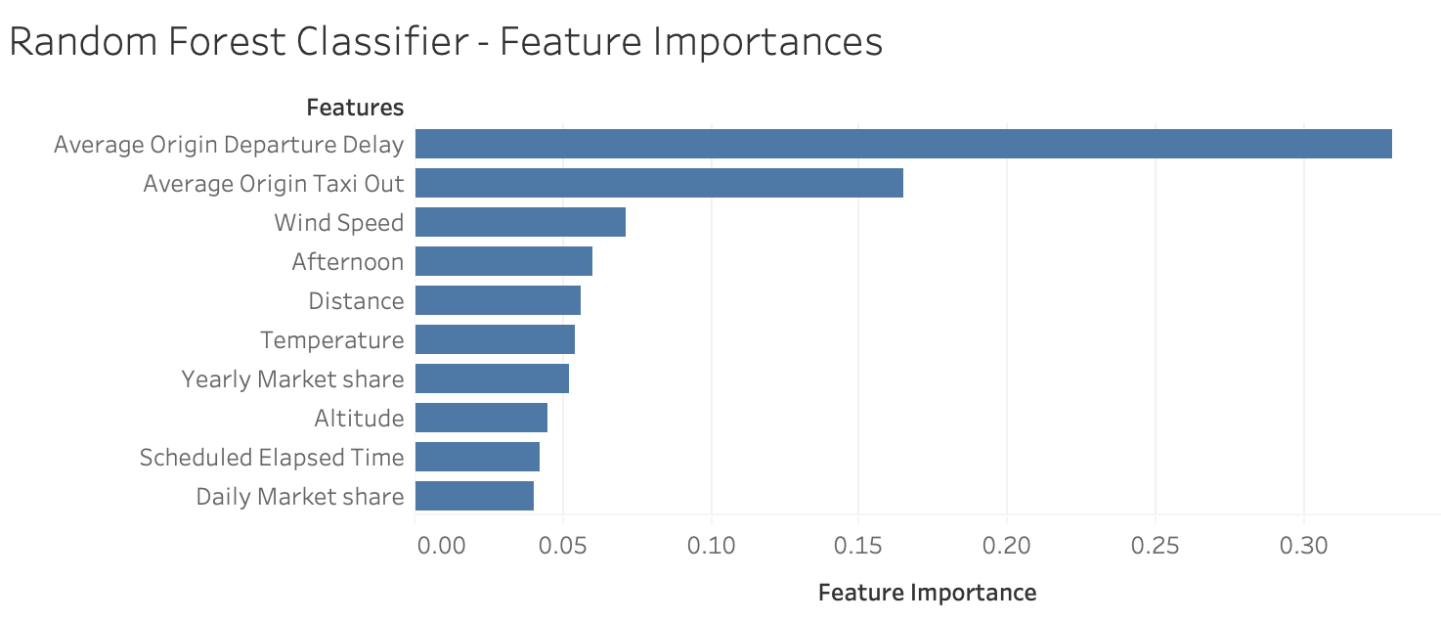
Predicting Flight Cancellations Most Important Features

Slide 11
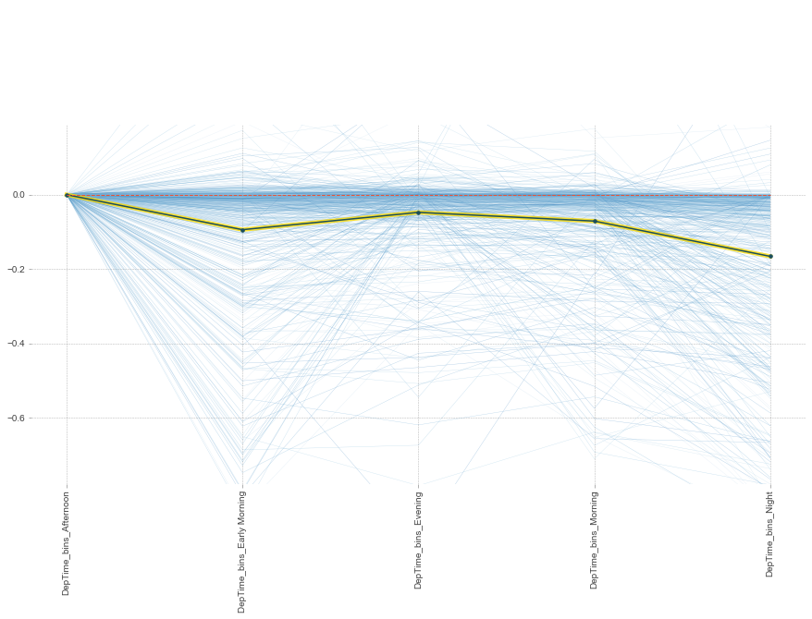
Recommendations (iii)
Flight cancellations
Changing the time of the departure for some flights

Slide 12
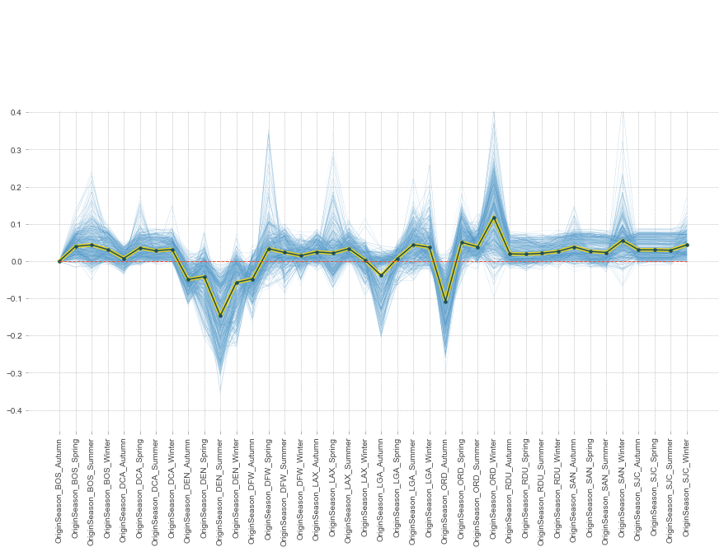
Recommendations (iv)
Flight cancellations
Reducing the usage of Chicago O'Hare International Airport

Slide 13
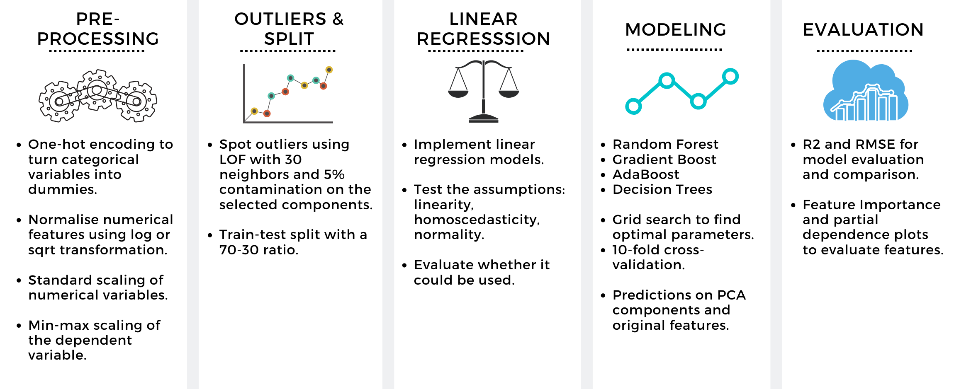
Predicting Departure Delay

Slide 14
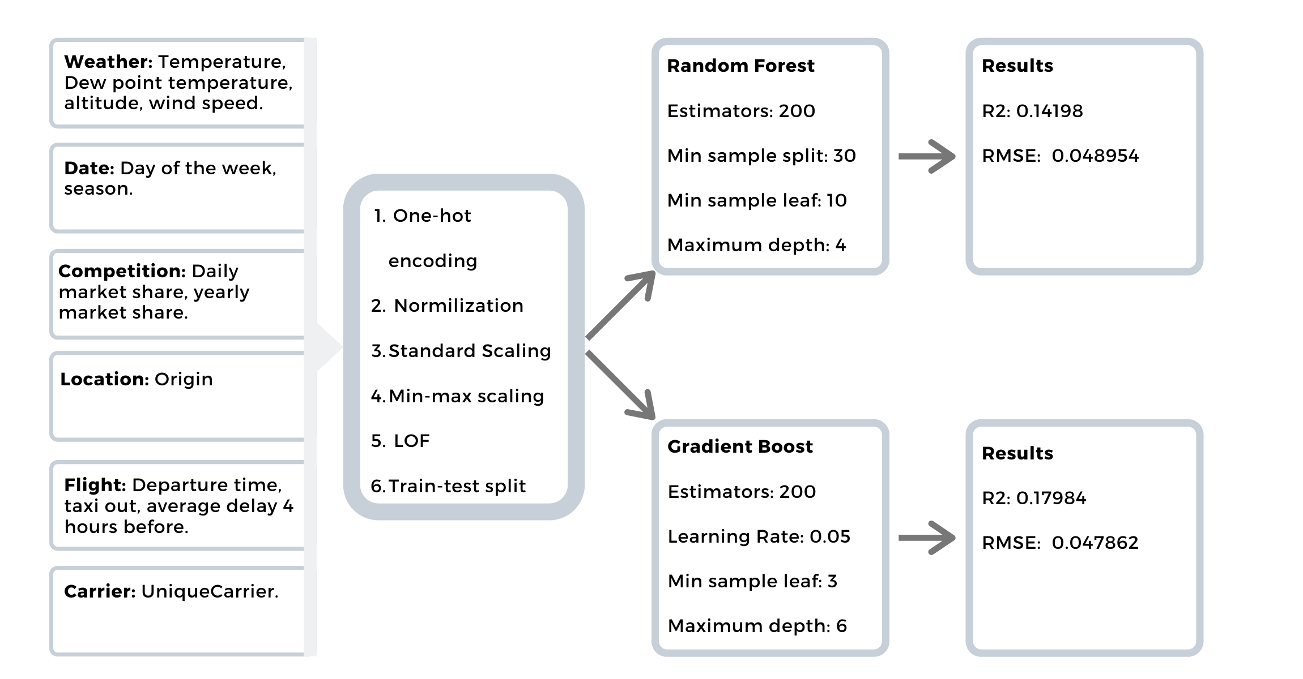
Predicting Departure Delay Best model

Slide 15
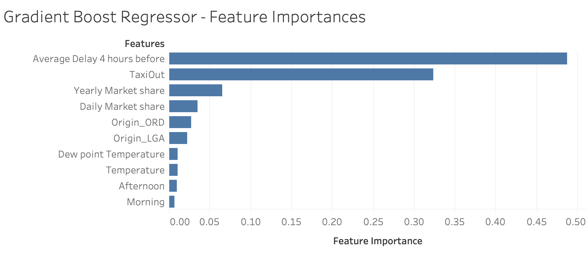
Predicting Departure Delay Most Important Features

Slide 16
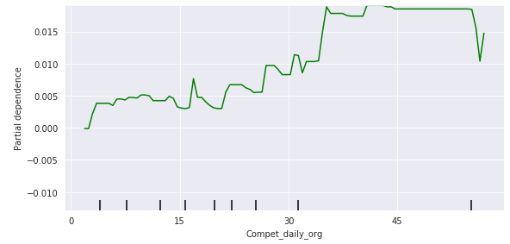
Recommendations (i)
Flight delays
Re-evaluating flight management process

Slide 17
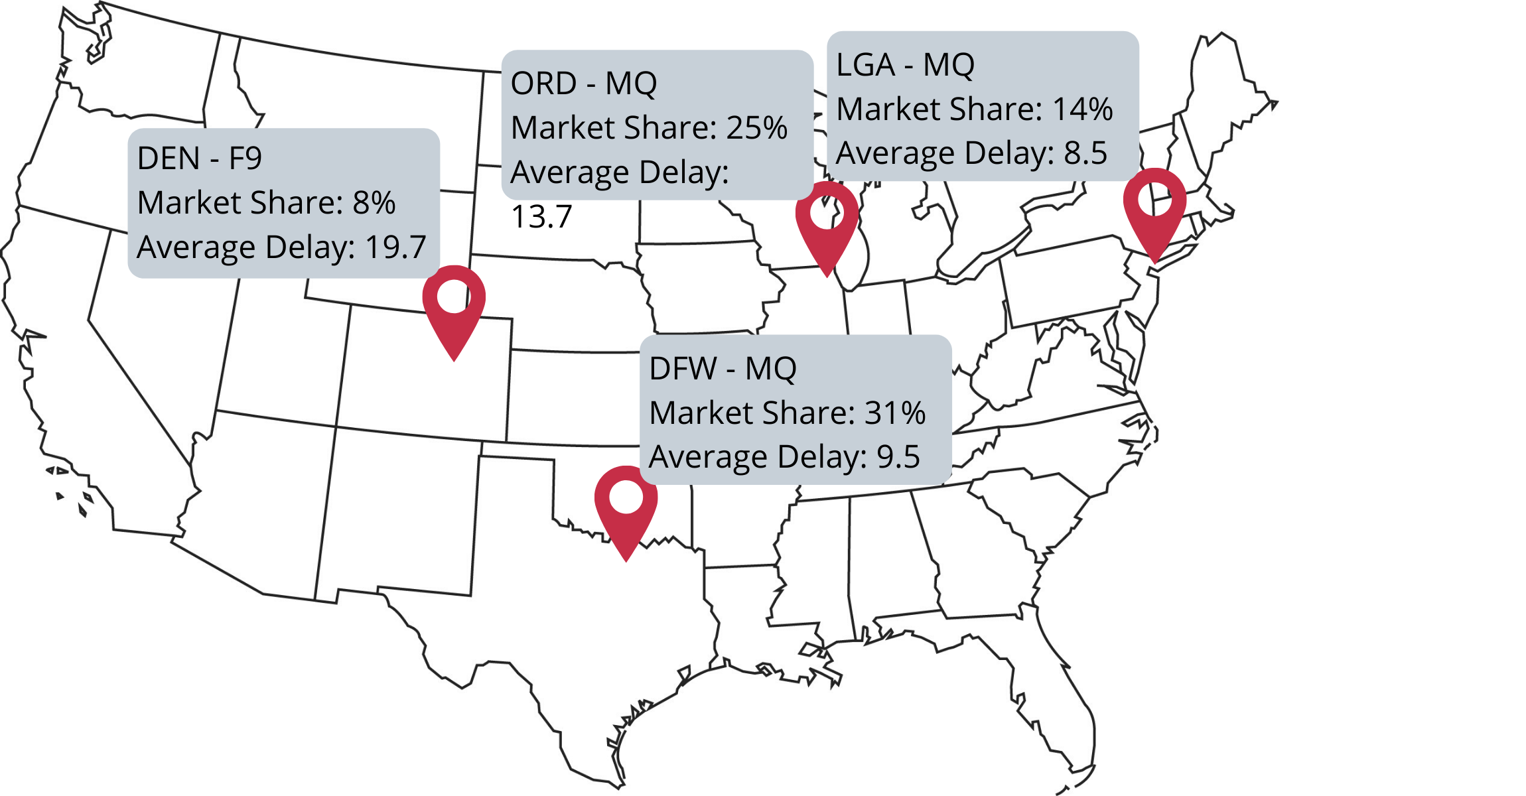

Slide 18
Thank you for your time!

